Slide 1
MOVIEHUB – THE Movie Application
Presented by
Pranay Kumar Rayarao
Vincy Jeba Shanthi
Yaswantha Nagarjuna Konijeti
Date: 26-07-2022
Place: Microsoft-teams

Slide 2
About Movie-HuB
All the internet user can access the movie-hub.
Allow smart search.
Also find popular and trending movies.
User can play the movie, view the movie details etc.
Movie app provides many features for registered users.
For registered user- favorite, watch later
Recommend movies to user.
Allow users to edit their profile and upload profile picture.
Friendly User Interface

Slide 3
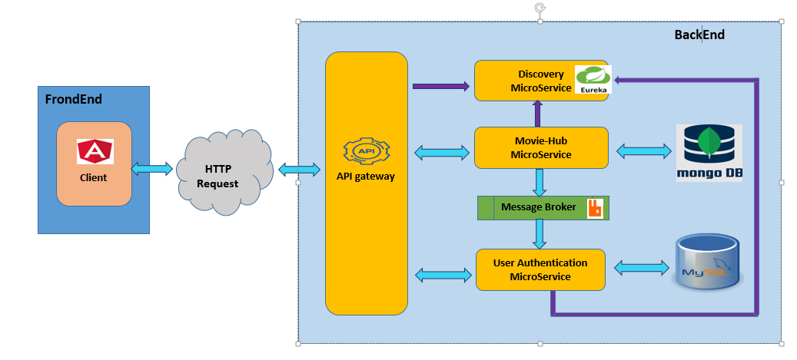
Architecture Diagram

Slide 4
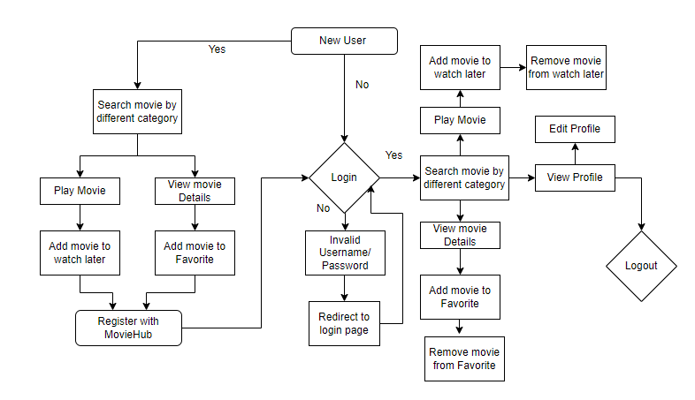
Flow Diagram-user

Slide 5
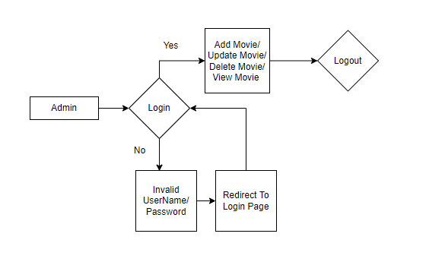
Flow Diagram- Admin

Slide 6
Tools And Technologies
Programming Language: Java
Libraries and frameworks: Spring Boot, JPA
UI and Web development frame works: Angular
Script : JavaScript
Databases : MySQL, MongoDB
Web technologies : HTML, CSS, Bootstrap, Angular Material
Testing tools and frameworks: Junit
IDE: IntelliJ IDEA, Visual Studio Code
Database modelling tools: MySQL Workbench, MongoDB Compass

Slide 7
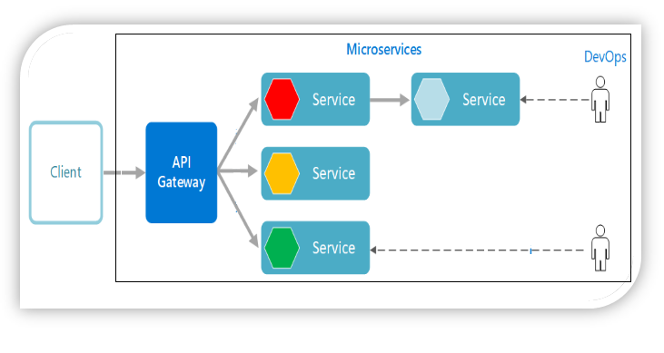
Micro-services
User authentication service
Movie application service
API gateway
Discovery service

Slide 8
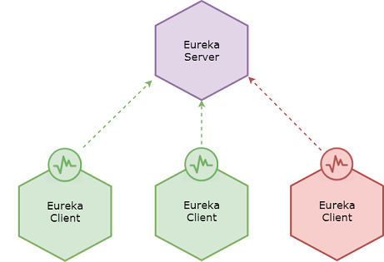
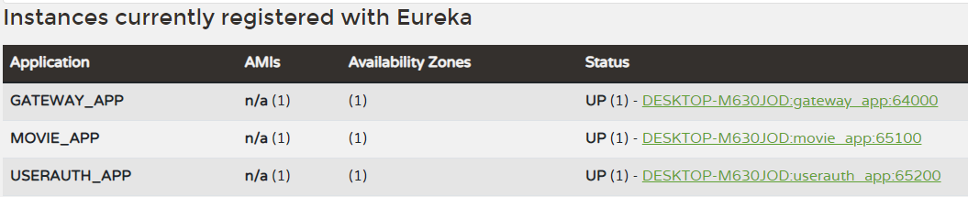
Discovery Service
Services are registered to the discovery server.
Discovery service listens for the registered service when they start up.
Eureka Server Dashboard:

Slide 9
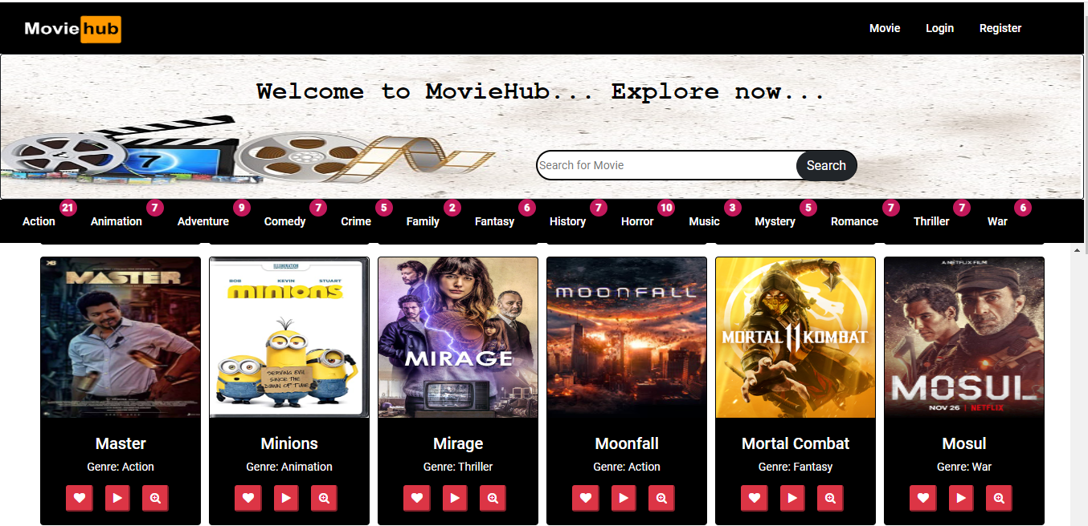
Movie Service

Slide 10
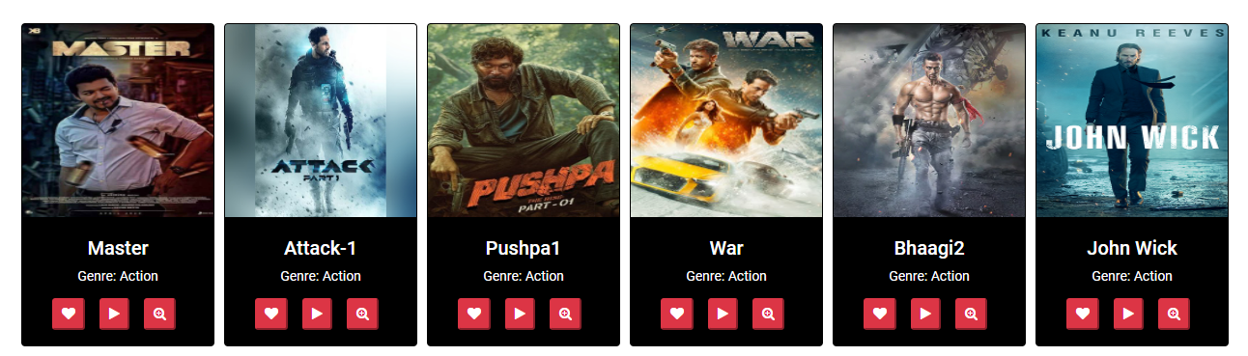
Movie Service
Add to favourite
View Movie Details
Play Movie

Slide 11
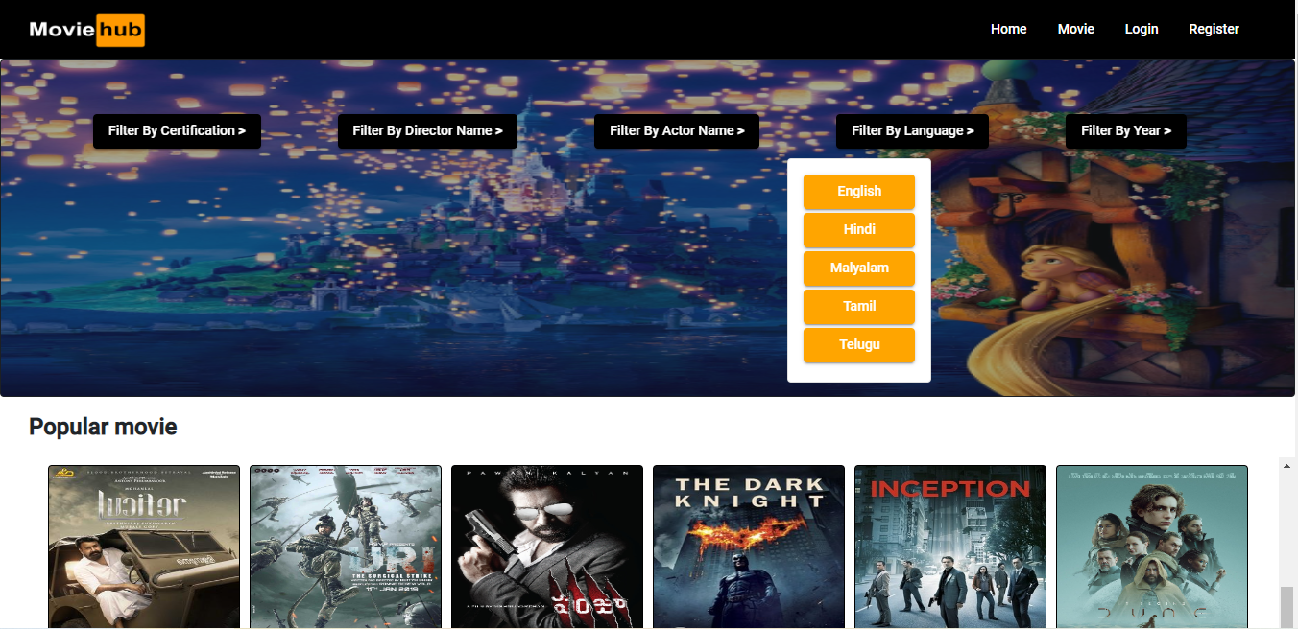
Popular

Slide 12
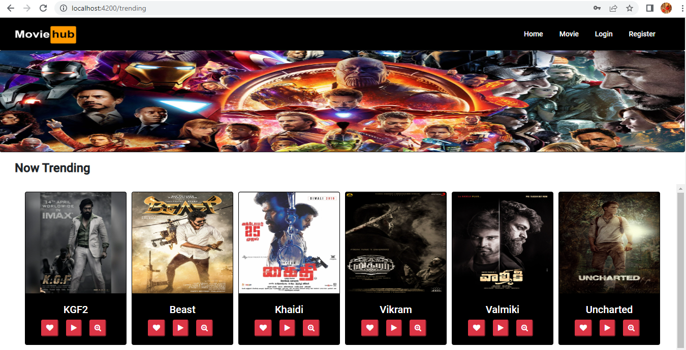
Trending

Slide 13
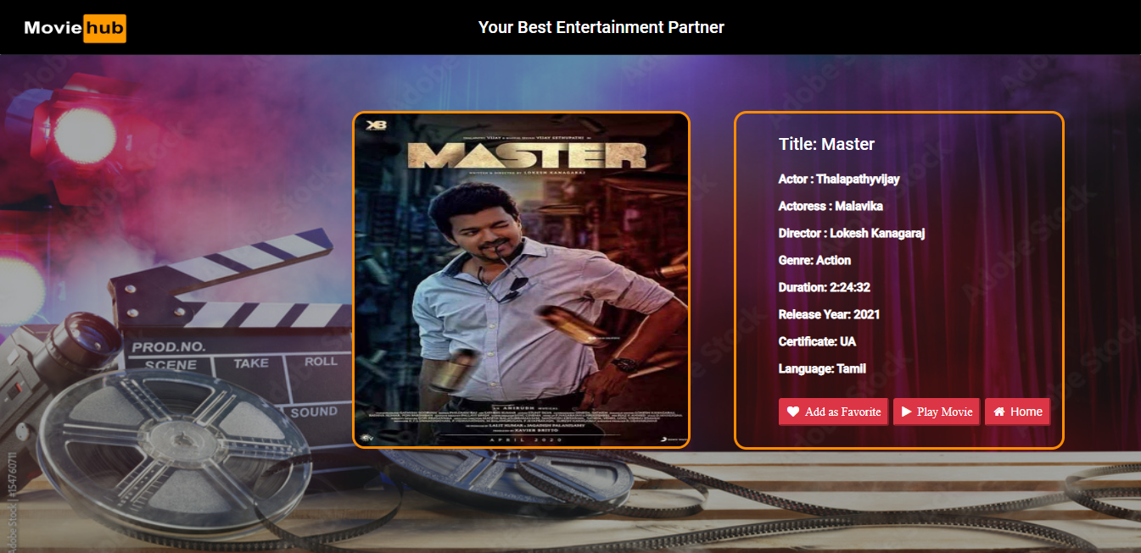
View movie details

Slide 14
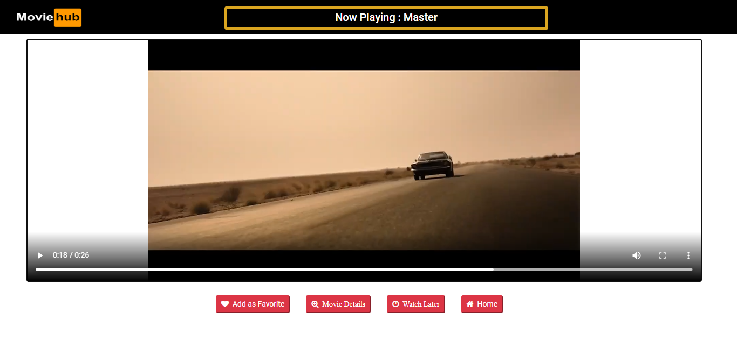
Play movie

Slide 15
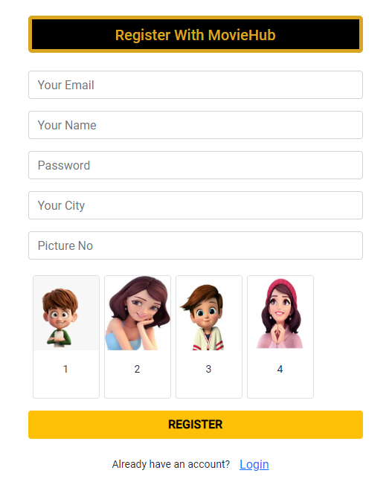
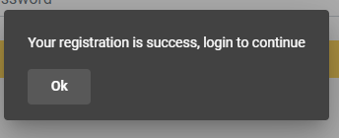
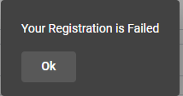
User Registration
First time user can register/ create his/her account
.

Slide 16
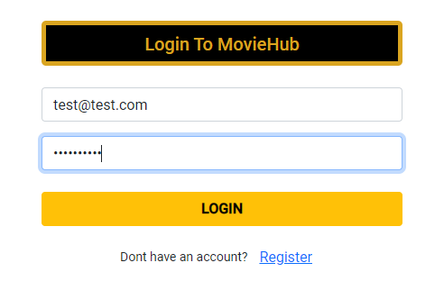
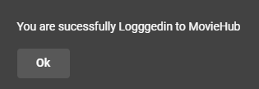
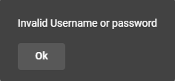
USER Login
Registered user can login using email id and password

Slide 17
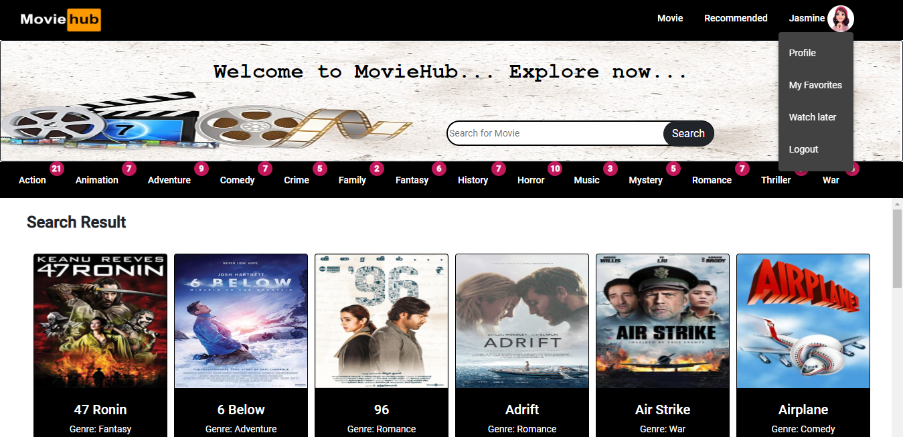
User home-page

Slide 18
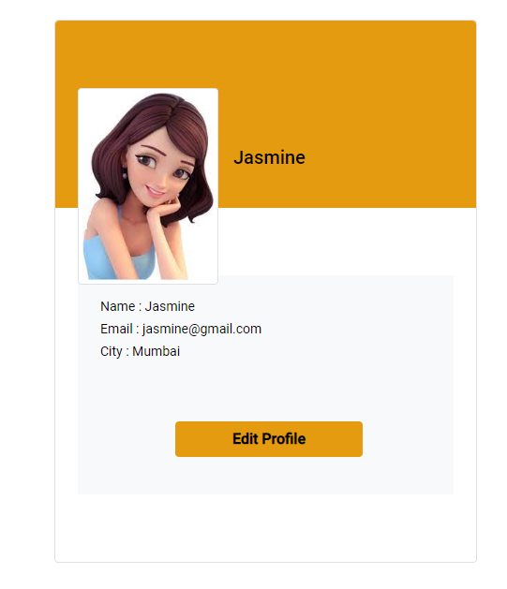
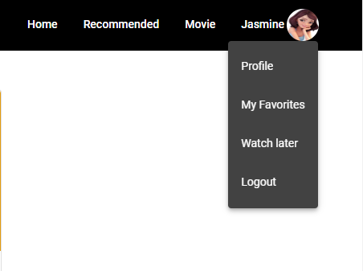
User Profile
User can edit their profile and upload profile picture.

Slide 19


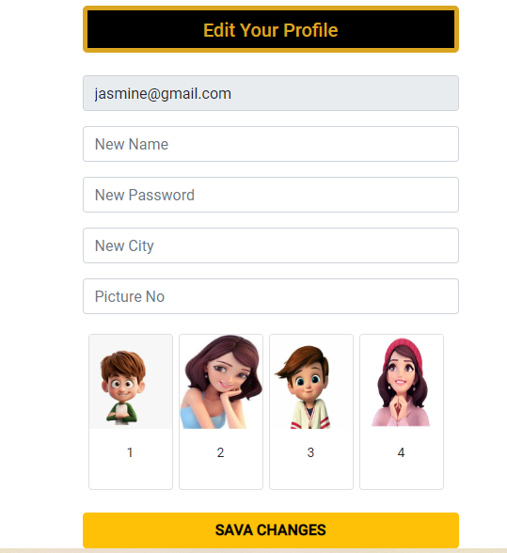

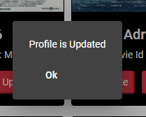
Edit user profile

Slide 20
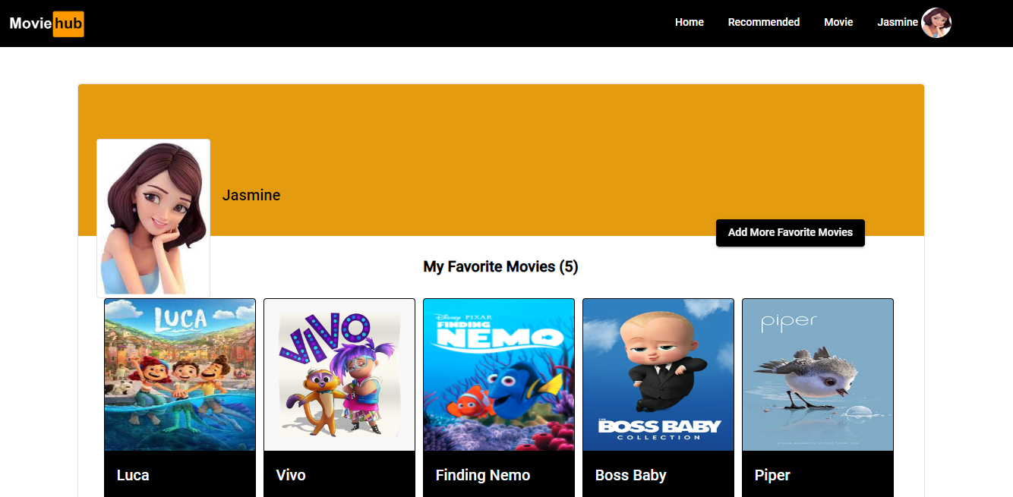
User Favorite

Slide 21
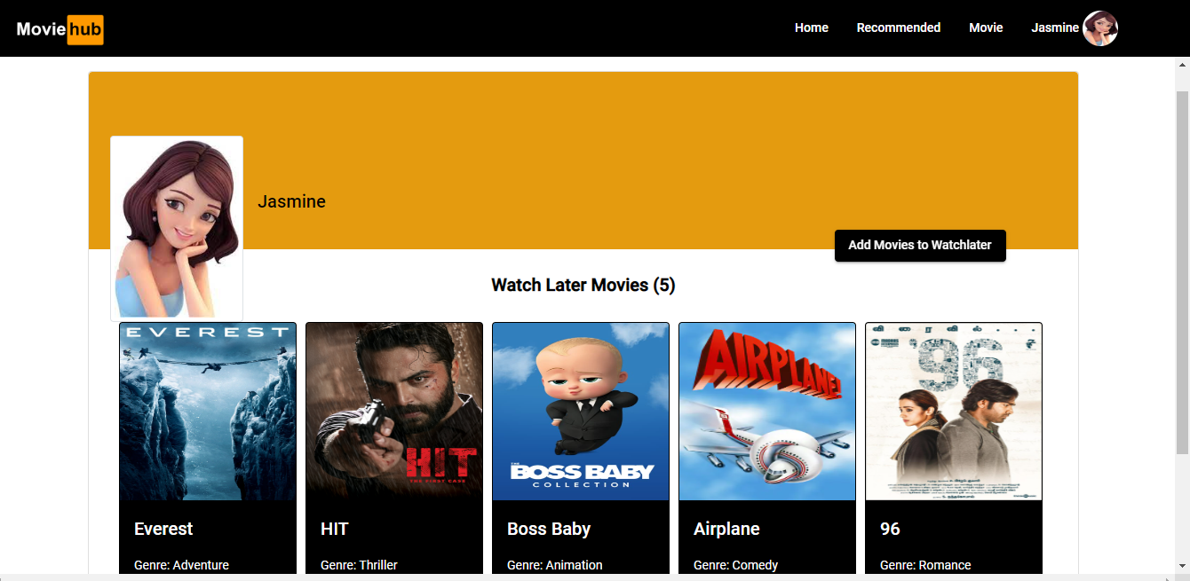
Watch later

Slide 22
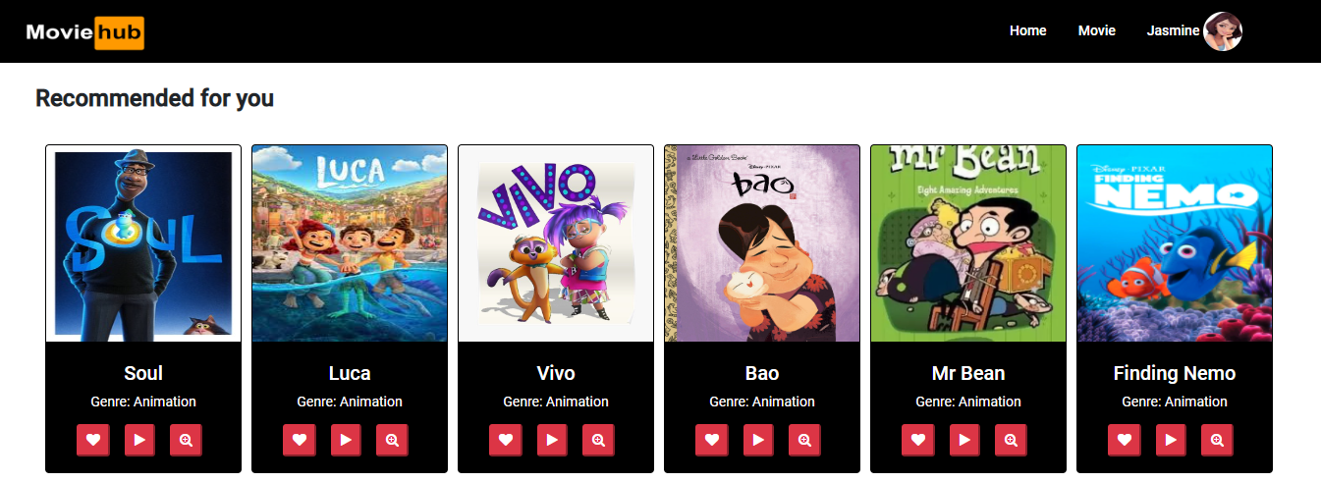
User Recommendation

Slide 23
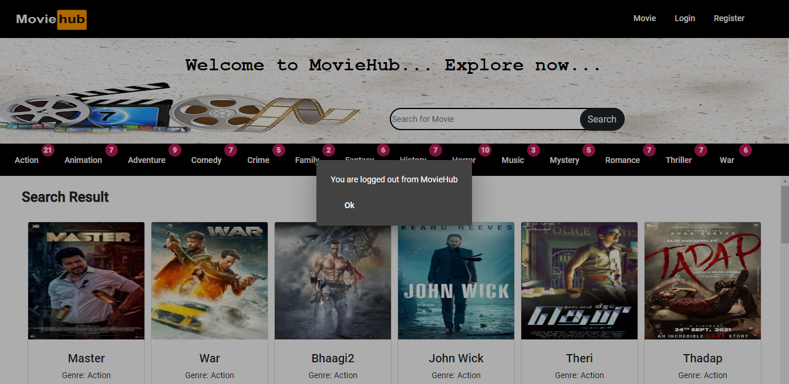
User Logout

Slide 24
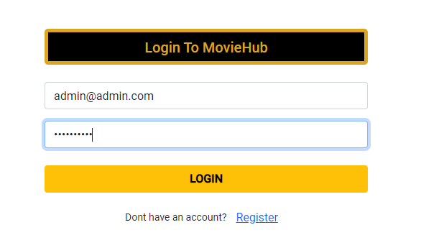
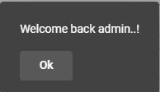
Admin login

Slide 25
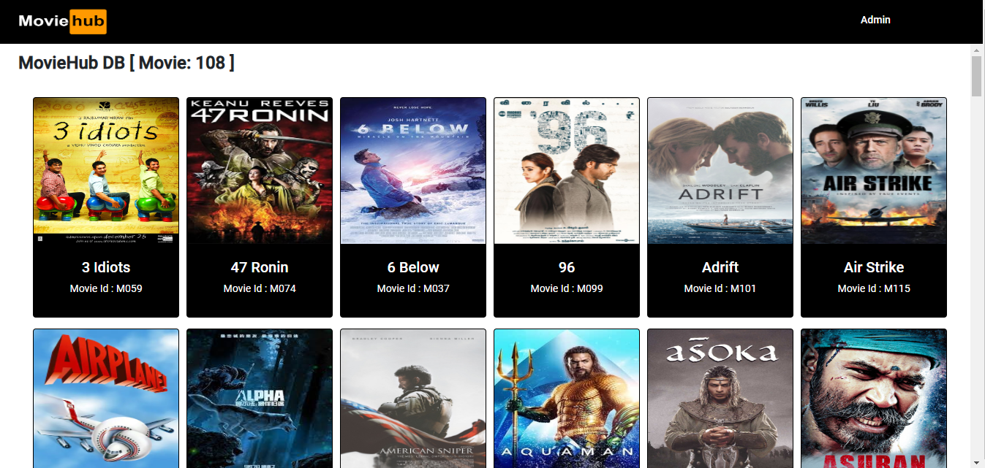

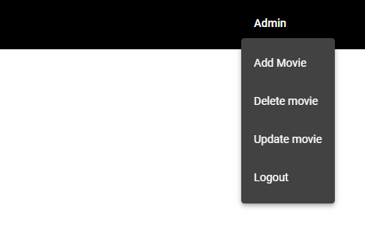
Admin

Slide 26
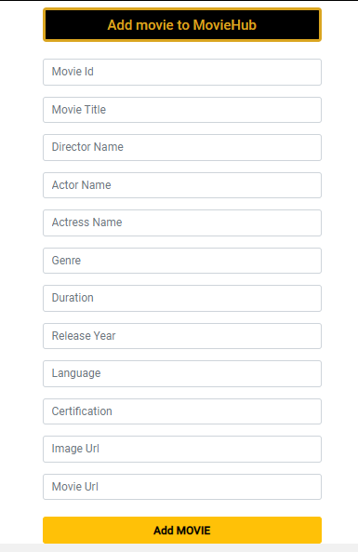
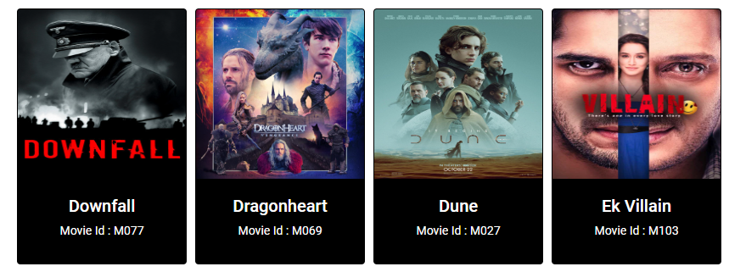
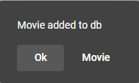
ADD MOVIE

Slide 27
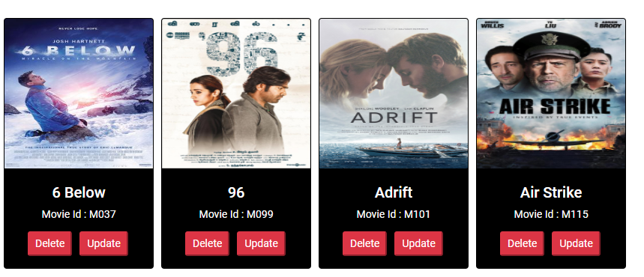
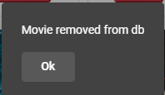
Delete movie
Delete Movie
Update Movie

Slide 28
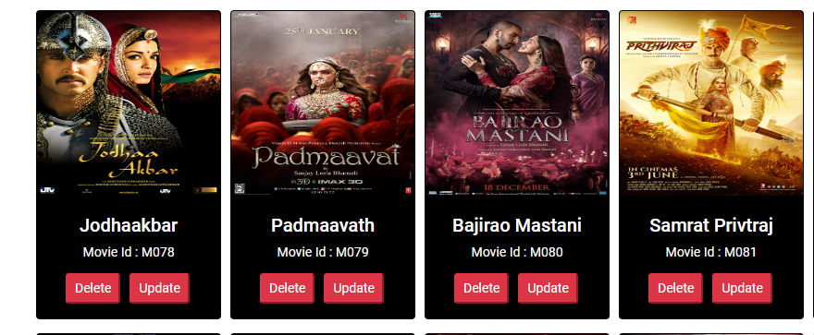
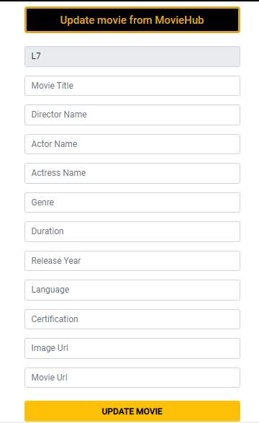
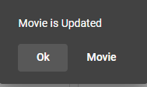
update movie

Slide 29
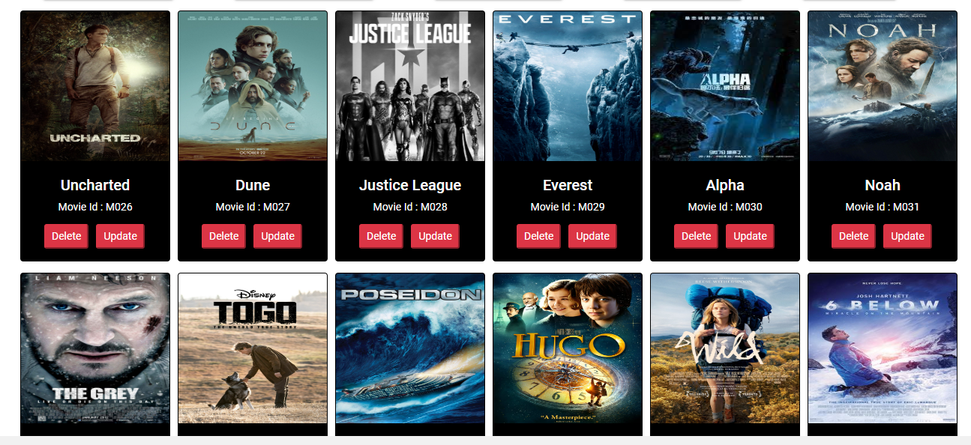
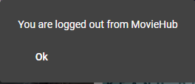
Admin Logout

Slide 30







Movie-hub demo

Slide 31





feature enhancement
Registered user can create watch list.
User can give the rating for the movie.
Improve the recommendation for the user.
Forgot password – mail service

Slide 32




Questions…?

Slide 33






We would like to take this opportunity to express our gratitude and thanks to our mentors,
Mr Rajeswar
Mrs Tabassum Hasan
Mrs Gayatri

Slide 34
THANK YOU…!

